Slide 1
CSCI2100E Data Structures: Course information
Hong Cheng
Department of Systems Engineering and Engineering Management
The Chinese University of Hong Kong

Slide 2
CSCI2100D: Course info (i)
Instructor: Hong Cheng, Room ERB 707, hcheng@se.cuhk.edu.hk
Tutor: Bian Tian tbian@se.cuhk.edu.hk
Huang Minbin mbhuang@se.cuhk.edu.hk
Tan Jie jtan@se.cuhk.edu.hk
Zhao Xiaoyan xzhao@se.cuhk.edu.hk
Class Schedules: Monday 9:30–11:15
Wednesday 10:30-11:15
Resources/Announcements:
BlackBoard (CUHK Elearning System)

Slide 3
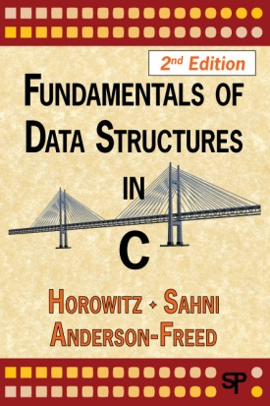
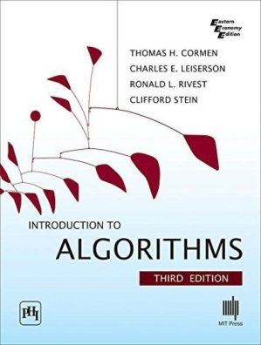
CSCI2100D: Course info (ii)
Textbook:
Fundamentals of Data Structures in C
by Ellis Horowitz, Sartaj Sahni and Susan Anderson-Freed, Computer Science Press
Ebook@CUHK library
Exercise Solutions can be found at http://www.cise.ufl.edu/~sahni/fdsc2ed/
More references:
Introduction to Algorithms
By Thomas H. Cormen, Charles E. Leiserson,
Ronald L. Rivest, and Clifford Stein.
Ebook@CUHK library

Slide 4
Review of C Programming
An interactive C Programming eBook, with micro-modules and online self-learning exercises by Dr. T. Y. WONG
http://cprog.erg.cuhk.edu.hk/
Connect to the CUHK Network via VPN before accessing this online learning resource.
Features:
The materials are divided into chapters and sections.
Micro-modules are short video clips for self-learning.
You may attempt the online exercises for self-testing and getting instant feedback.
You may even write, run and test C program online!

Slide 5
Assessment
Four programming Labs: 20%
Three Written Assignments: 20%
Midterm exam: 20%
Final exam: 40%

Slide 6
Course Objectives & Outcomes
Course Objectives:
To learn Logical and Systematic approach to Problem Solving in Information Systems as well as other areas using Data Structures and Algorithms.
To learn Problem Solving from a high-level and modular approach with the Abstract Data Type style.
Course Outcomes:
Have the knowledge of various fundamental data structures and their usefulness.
Able to combine, modify and design new data structures for tackling new problems.
Acquiring and strengthening individual problem analysis, design and programming skills.
Able to relate to high-level and modular approach with Abstract Data Type style problem solving. This can be applied to technical as well as managerial problem solving.

Slide 7
University Policy on Academic Integrity
https://www.cuhk.edu.hk/policy/academichonesty/
Offences:
plagiarism
hiring 3rd party to do assignments/projects
hiring 3rd party to do tests/final exams
uploading professors' course materials (including lecture slides and assignment specifications) to commercial cheating platforms
Penalties:
permanent demerits in the students' records
lowering of degree classification
suspension and possibly expulsion from school

